Slide 1
自備病例範例
三分鐘報告
七分鐘答辯

Slide 2
建議考生
三分鐘報告
1.簡單說明主訴
2.說明治療計畫、使用裝置、biomechanics、如何控制Anchorage
3. 扼要說明治療前後之口內外比較與測顱X光比較

Slide 3
病例 (B) 屬性 ：h
Severe maxilla-mandible basal bone discrepancy: sagittal and transverse
中華民國齒顎矯正學會
專科醫師口試病例

Slide 4
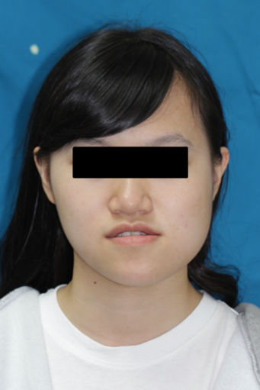
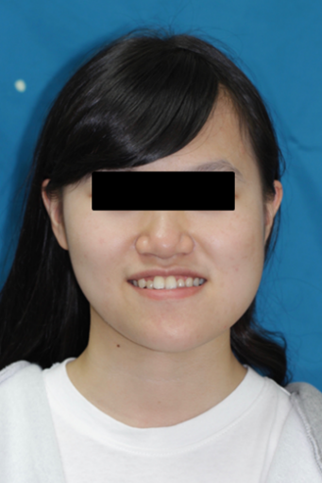
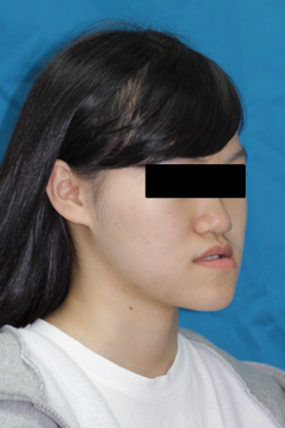
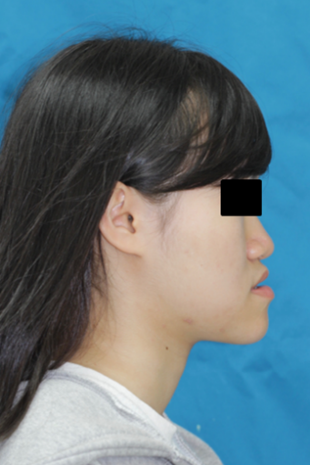
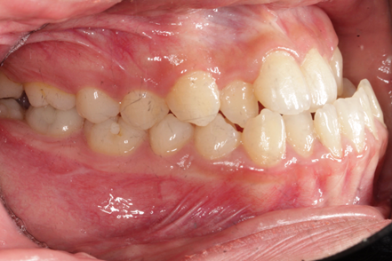
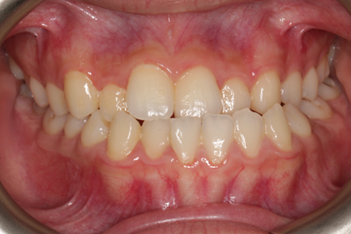
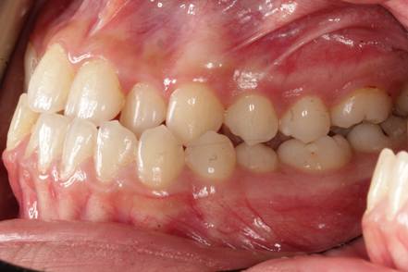
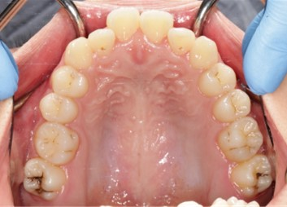
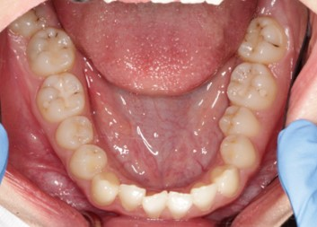
治療前
Gender : female
Age : 18yr
CC : 戽斗、臉歪

Slide 5
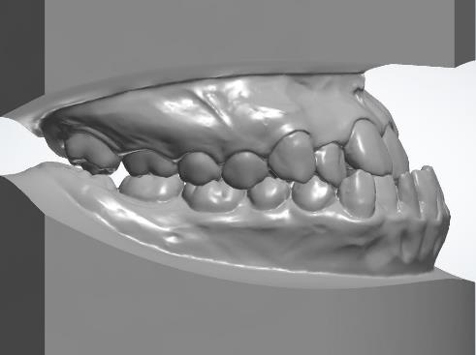
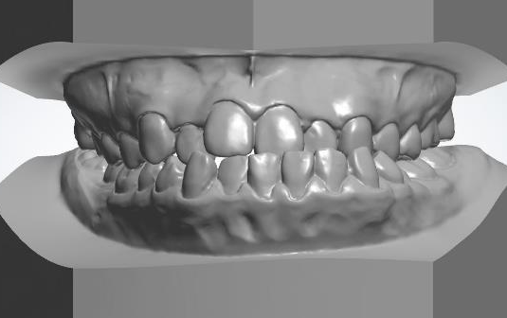
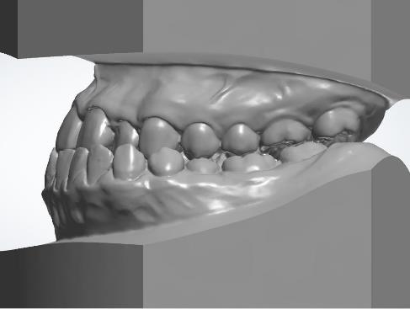
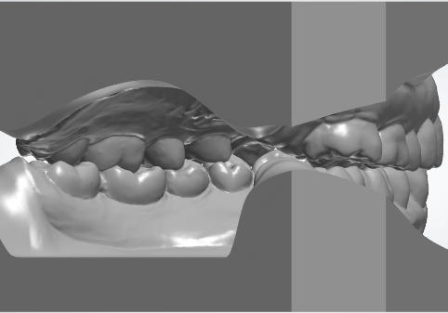
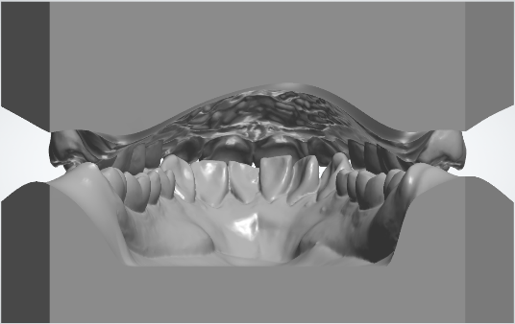
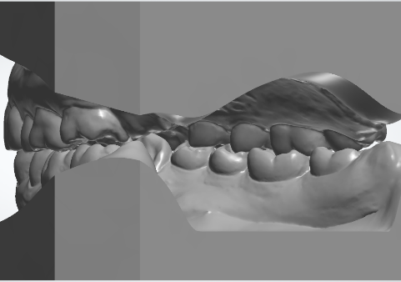
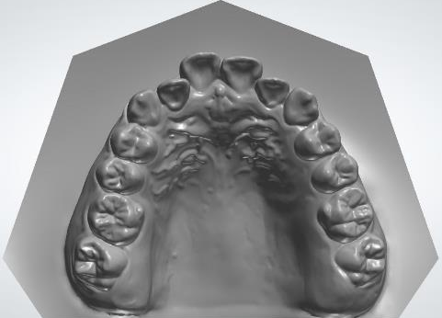
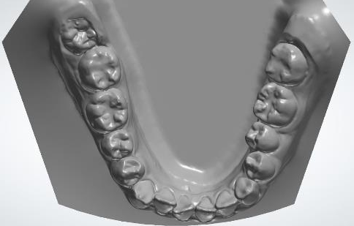
Initial record
 | Canine | Molar
R’t | Class III | Class III
L’t | Class III | Class III

Slide 6
Treatment plan - Two jaw Surgical-orthodontic treatment
U/A: Ext. 14,24,18,28
Q1Q2 TADs for maximum anchorage preparation
L/A: Ext. 38,48
Q3 arch expansion
OGS:
Maxilla: Lefort I osteotomy yaw rotation
Mandible :BSSO rotational setback and side shifting to right
side
Maxillomandibular complex clockwise pitch rotation
Finish at Class I canine and Class II molar relationship
Retention : Vacuum formed + Wraparound retainer
6
Notes:
因此根據前面的tx. goal, 給予一個pure-ortho的治療計劃, 預計拔除38, 上顎在建立archform後會將前牙往前flare, 下顎則會放上screw做後牙的uprighting及whole arch distalize, 過程中會配戴雙側short Class III elastics去幫助後牙區的extrusion與打平curve of Spee, 最後finish在canine及molar Class I的咬合關係

Slide 7
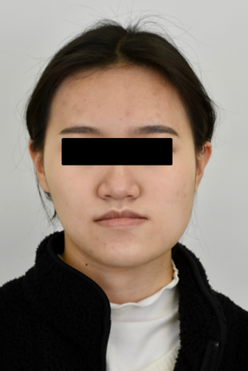
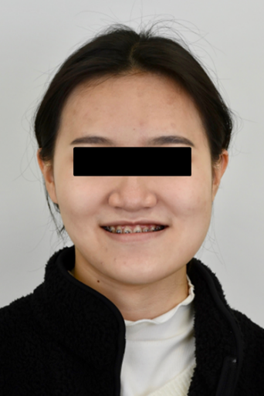
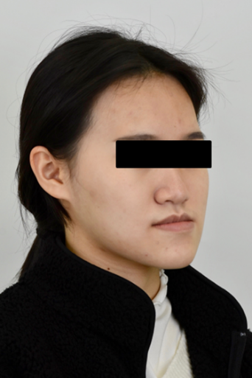
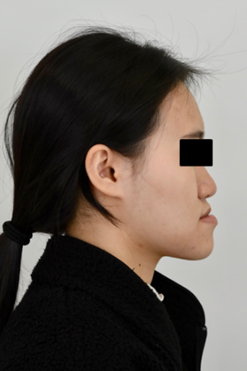
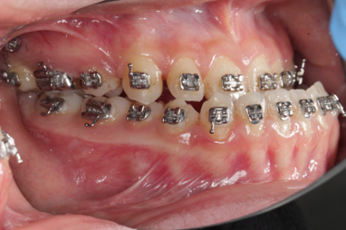
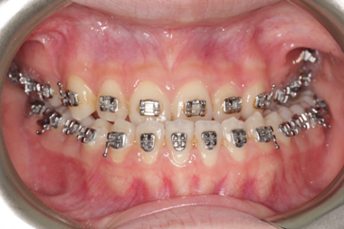
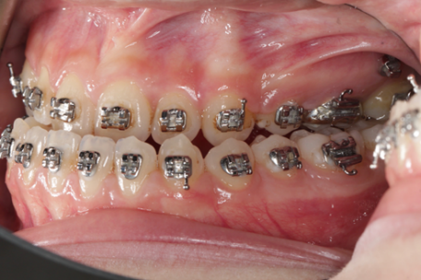
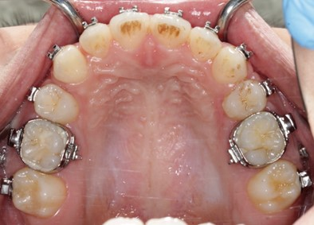
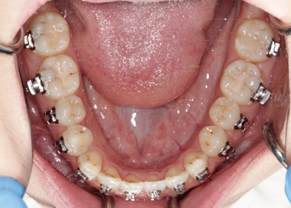
手術前
2023.12.19 (13M)

Slide 8
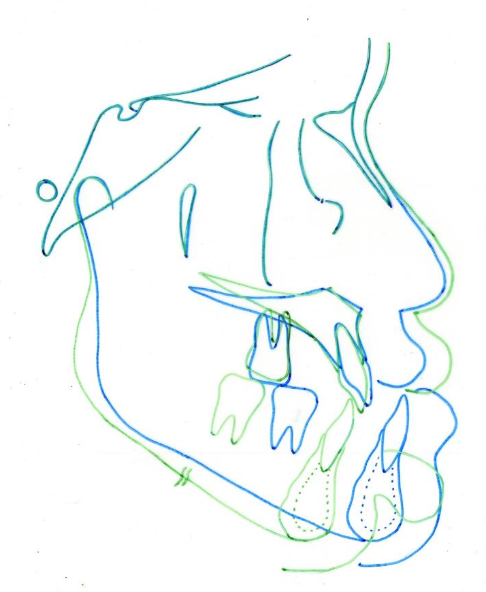
Superimposition – post surgery
- Pre-OP
- Post-OP
Maxilla
Clockwise pitch rotation
- ANS downward 2 mm
- PNS impaction 4.5 mm
Yaw rotation 4 degree
Mandible
Bilateral Sagittal Split Osteotomy
Clockwise pitch rotation
- Setback (Point B) 17 mm
- Side shift to Right

Slide 9
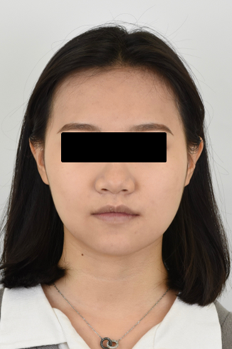
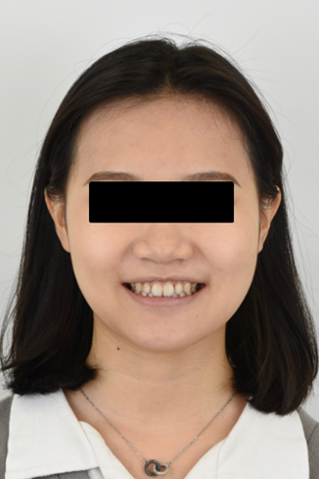
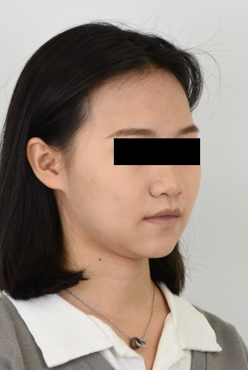
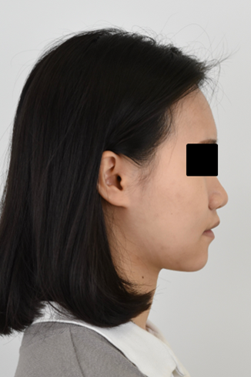
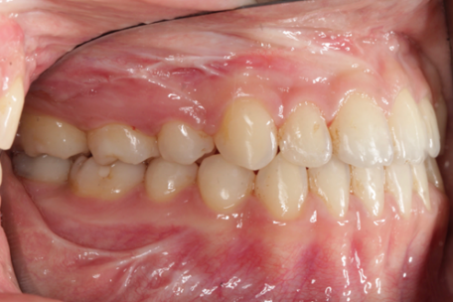
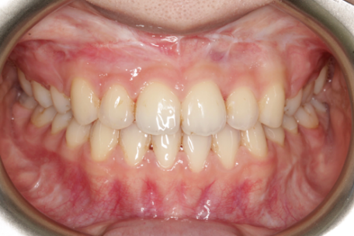
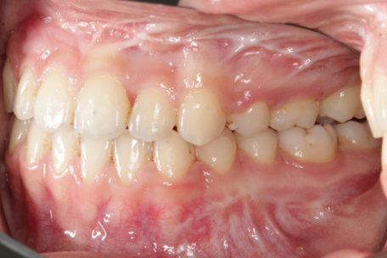
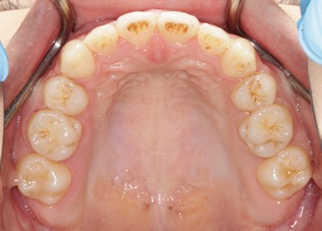
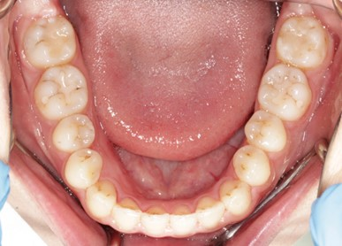
治療後
2024.02.22 (15M)

Slide 10
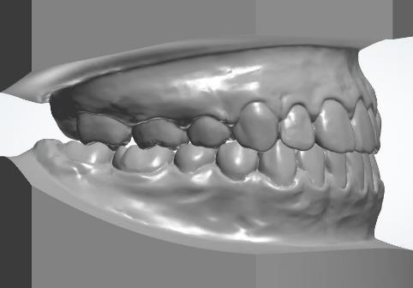
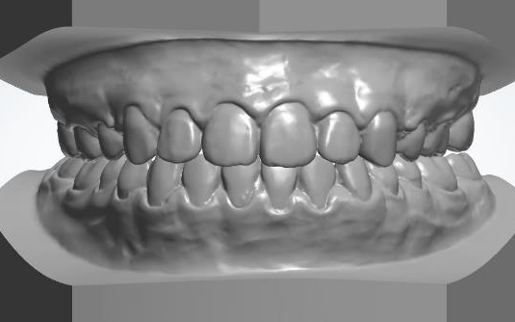
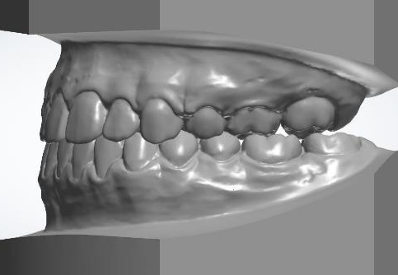
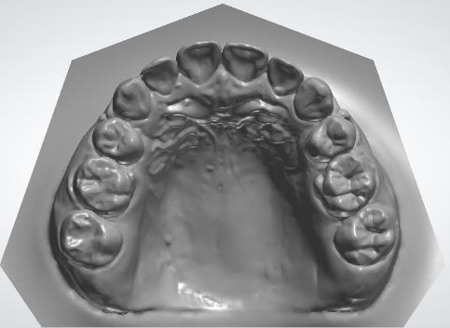
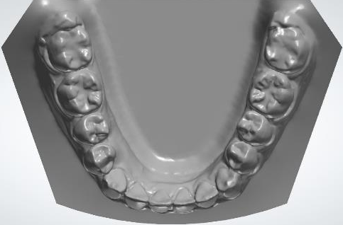
Final record

Slide 11
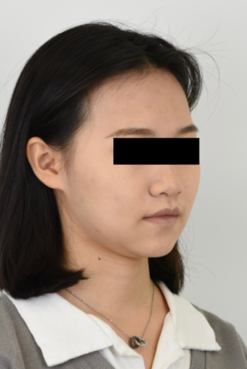
治療前、後比較

Slide 12
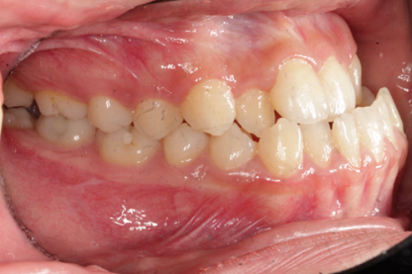
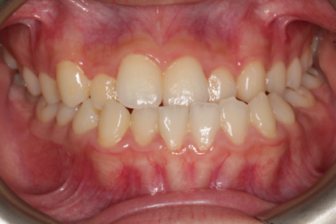
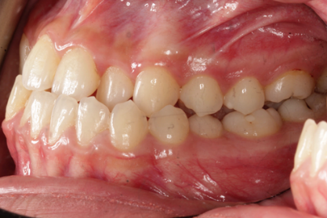

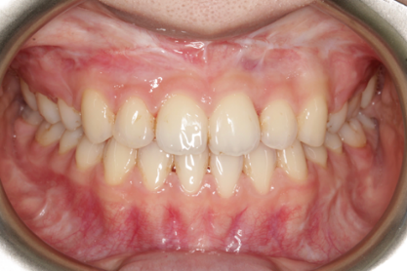

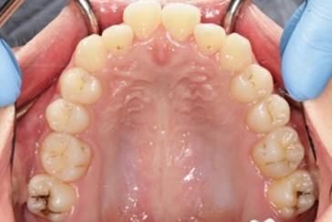
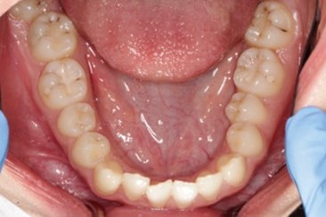
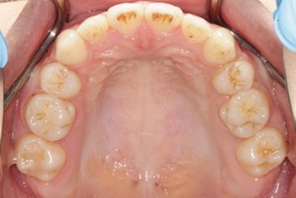
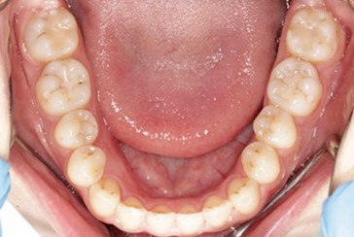
治療前
、後比較

Slide 13


治療前
、後比較

Slide 14


治療前
、後比較

Slide 15

Superimposition - Overall
Pre-Tx
Post-Tx
定位於Ｓ點，重疊於S-N line上
Maxilla :
Clockwise pitch rotation
- ANS downward 2 mm
- PNS impaction 4.5 mm
Mandible :
Clockwise pitch rotation
Setback 16 mm (Point B)

Slide 16

Superimposition - Mx
Pre-Tx
Post-Tx
定位點為ANS,重疊平面為Palatal plane
U1 :
Retract 5 mm
Extrude 0.5 mm (edge)
U6 :
Mesialized 3 mm

Slide 17

Superimposition - Md
Pre-Tx
Post-Tx
定位點symphysis內緣後緣，下顎神經管，重疊平面為Mandibular plane
L1 :
Maintain
L6 :
Extruded 1 mm

